Slide 1
Mini Project-ML
By-Sharwan Kumar (April Batch)

Slide 2
Introduction
There are 3 most common regression model for data prediction .
They are-Linear regression, polynomial regression and Multiple regression.
Here in this minor project I have used all the 3 model to data prediction and from that you will get to know which is best among all i.e. which model gives the most closest value.
Here we will also calculate the errors in each model, r2 score and many more and from that we can compare the models

Slide 3
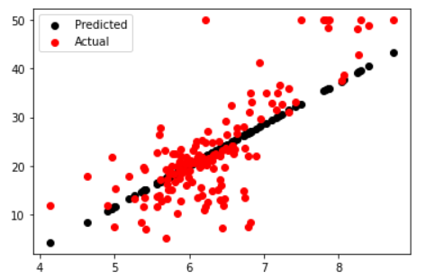
Linear Regression
It predicts the value of one variable by analyzing the data of another variable . Here the variable which we want to predict the value is know as dependent value and other is know as independent variable.
Here I have drawn graph between the actual and the predicted value of ‘medv’ using linear regression.

Slide 4
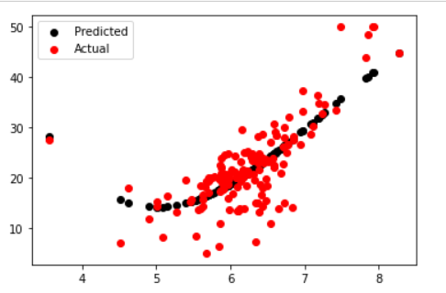
Polynomial Regression
It’s the special case of multiple linear regression.
Here in polynomial regression the dependent variable and independent variable is modeled as an nth degree polynomial.
Here I have drawn graph between the actual and the predicted value of ‘medv’ using Polynomial regression.

Slide 5
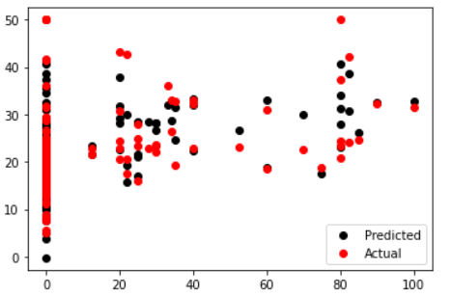
Multiple Regression
It predicts the value of one variable by analyzing the data of rest of the datasets . Here the variable which we want to predict the value is know as dependent value and all the other data sets acts as independent variable.
Here I have drawn graph between the actual and the predicted value of ‘medv’ using multiple regression.

Slide 6
Data Description
The Boston Housing Dataset
The Boston Housing Dataset is a derived from information collected by the U.S.
Census Service concerning housing in the area of Boston MA. The following
describes the dataset columns:
CRIM - per capita crime rate by town.
ZN - proportion of residential land zoned for lots over 25,000 sq. ft.
INDUS - proportion of non-retail business acres per town.
CHAS - Charles River dummy variable (1 if tract bounds river; 0 otherwise)
NOX - nitric oxides concentration (parts per 10 million)
RM - average number of rooms per dwelling
AGE - proportion of owner-occupied units built prior to 1940
DIS - weighted distances to five Boston employment centers
RAD - index of accessibility to radial highways
TAX - full-value property-tax rate per $10,000
PTRATIO - pupil-teacher ratio by town
Black - 1000(Bk - 0.63)^2 where Bk is the proportion of blacks by town
LSTAT - % lower status of the population
MEDV - Median value of owner-occupied homes in $1000.
Here total of 506 rows and 14 columns are their and we need to find which factor is most accurate in determining the value of medv.

Slide 7
Approach
I have predicted the medv value by linear, polynomial and multiple regression.
Just to show which model is more accurate I did all the 3 models and will show the comparison.
As in linear regression I came to know that there are no null values in the data which is good otherwise we have to will NAN values. We can get a dirty data and because of that we can cannot get an appropriate value so for that we need to do visualization but we should also know that complete remove of errors is impossible but up to some extent we can remove the errors.
As the data was same for polynomial and multiple regression I need not to check for the null values again but I did it because I have to do the comparison.

Slide 8
I find the r2 score of all the models and from that I came to know: Multiple regression > Polynomial regression > linear regression (in terms of accuracy of the data prediction)
Also plotted the graph between the actual and the predicted values.
Then find the different errors like:-mean absolute error, mean squared error and root absolute error.

Slide 9
Visualization
I have used scatter plot for data visualization by plotting the actual and the predicted value.
Data visualization has been done in all the 3 regression models.
Data visualization can be used for:
Making data easily to digest.
Identifying trends within a set of data.
Reinforcing an argument or opinion.
Highlighting the important parts of a set of data.

Slide 10
Linear Regression Visualization

Slide 11
Polynomial Regression Visualization

Slide 12
Multiple Regression Visualization

Slide 13
Algorithm
All the 3 algorithm were used (linear, polynomial and multiple regression) for comparison of errors, medv predicted value and many more.
In linear and polynomial regression I have used every single dataset for prediction of medv value but got the most appropriate value by taking independent variable as “rm”. In others I was having more errors and got less r2 score that’s why I found “rm” is best for independent variable.
As in multiple regression we have all the data set as independent variable except for the value that we have to predict.

Slide 14
Evaluation
F1 score – f1 score is the measure of test accuracy, it is calculated from the precision and recall of the test.
F1 score is the harmonic mean of precision and recall.
The highest F1 score is 1 and the lowest F1 score is 0.
--- 1-for best
--- 0- for worst
Here I found the F1 score

Slide 15
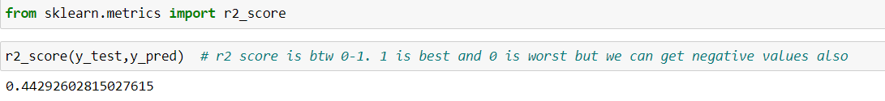
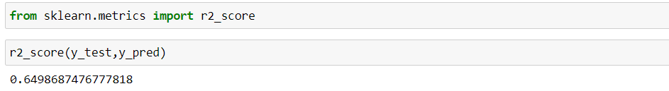
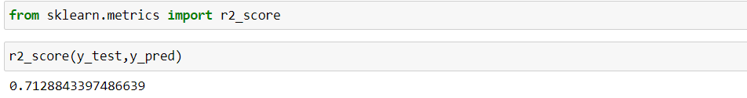
Comparison
Comparing models with r2 score:-
Linear regression
Polynomial regression
Multiple regression

Slide 16
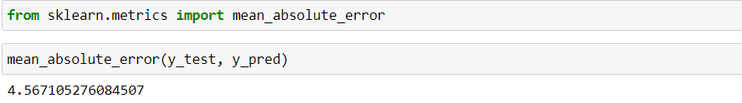
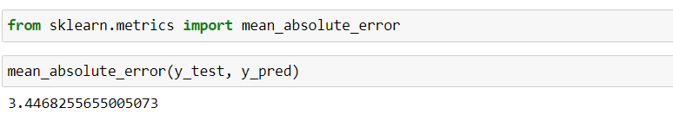
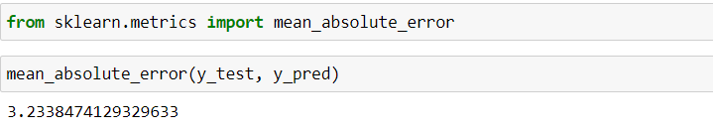
Comparison
Comparing model with mean absolute error:-
Linear regression
Polynomial regression
Multiple regression

Slide 17
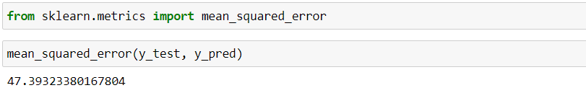
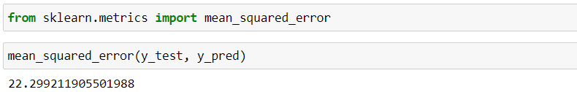
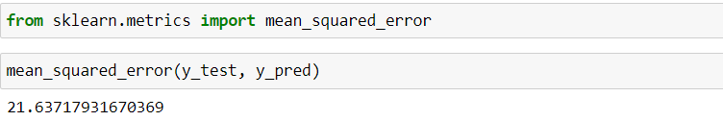
Comparison
Comparing model with mean squared error:-
Linear regression
Polynomial regression
Multiple regression

Slide 18
Result and discussion
*After doing all the preprocessing ,EDA, finding f1 score,r2 score and errors we came to point that multiple regression is the most accurate among linear regression and polynomial regression .
*The more the r2 score the better the model is :-
0.71 score in multiple regression
0.64 score in polynomial regression
0.44 score in linear regression
*The less the mean absolute error the better the model is :-
3.24 score in multiple regression
3.44 score in polynomial regression
4.56 score in linear regression
*The less the mean squared error the better the model is :-
21.63 score in multiple regression
22.29 score in polynomial regression
47. 39 score in linear regression

Slide 19
Conclusion
After applying all the visualization and seeing the results and discussion we came to know that multiple regression gives the best and the most accurate values than linear and polynomial regression gives.
As it has more r2 score , less mean absolute error and less mean squared error

Slide 20
Future work
Here future work mean analyzing the data more appropriately and finding all the possible errors .
Can even make the data more accurate by make the data more clean.
According to my present knowledge this is the most accurate result I got.

Slide 21
Difficulties faced
1st difficulty I faced was to join the two different dataset. I tries to use join function but was unavailable to join it then by searching over the internet I got to know that we should use “concat”.
As in Linear and polynomial regression we have only 2 types of dataset one is dependent and other is independent so their while specifying the value to X and y I faced value error . Then I tried to reshape(-1,1), then got the result.
In multiple regression I didn't get the accurate value when specifying all the data sets except the medv . I picked the most important datasets by applying hit and trial method and got most closest values of medv.

Slide 22
References
Daily classes codes/material given by sir.
https://www.analyticsvidhya.com/blog/2015/08/comprehensive-guide-regression/
https://www.upgrad.com/blog/types-of-regression-models-in-machine-learning/
YouTube

Slide 23
THANK - YOU

